Slide 1
Assessment of Key Risk Factors Driving Various Kind of Diseases on NHANES Dataset
BIOSTAT 625 Group 3
Jianxiong Shen
Shushun Ren
Zhiyi Sun

Slide 2
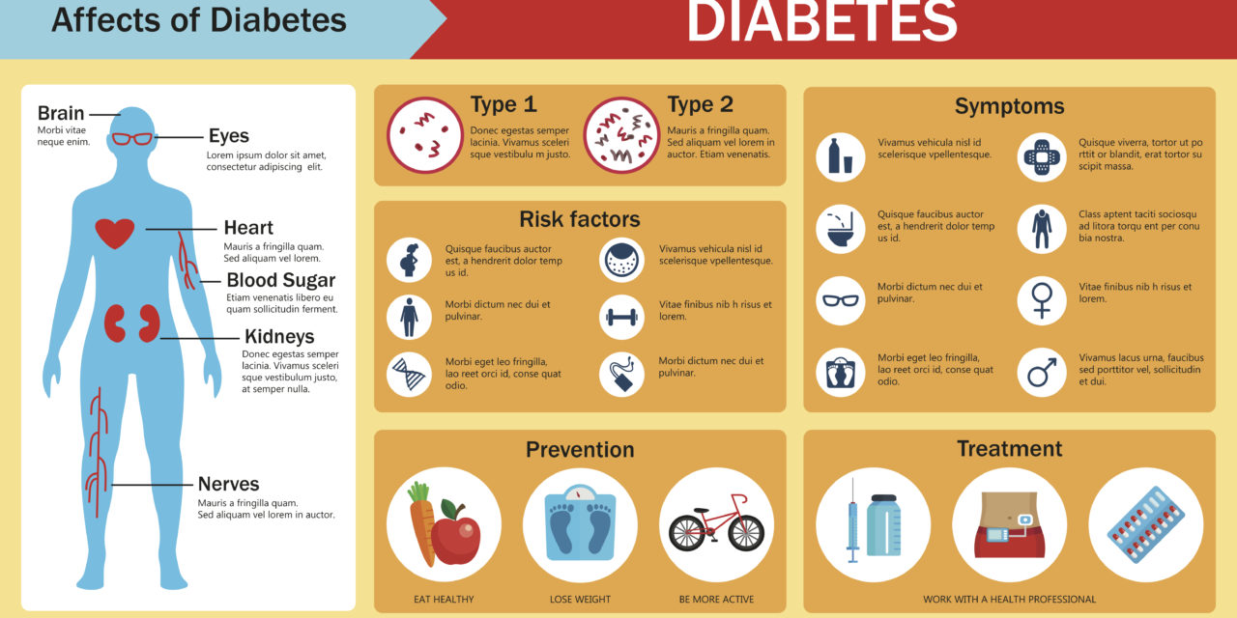
Background - Diabetes
About 34.2 million people of all ages – about 1 in 10 – have diabetes in the U.S. About 7.3 million adults aged 18 and older (about 1 in 5) are unaware that they have diabetes (just under 3% of all U.S. adults).
The number of people who are diagnosed with diabetes increases with age.
Factors that increase risks of diseases differ depending on the type of diabetes they ultimately develop.

Slide 3
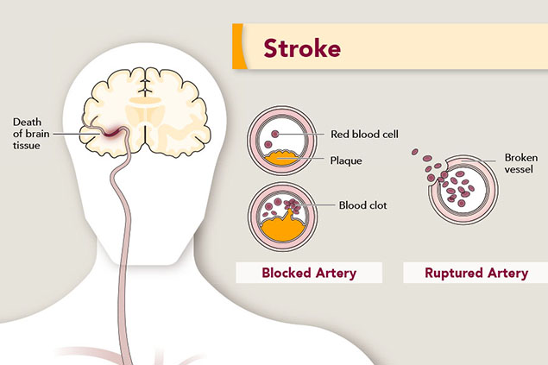
Background - Stroke (Further Study)
Stroke is a leading cause of death in the United States and is a major cause of serious disability for adults, and is a severe medical condition that requires emergency care.
Those who suffer from stroke, if luckily survived, may also suffer from expensive medical bills and even disability.
Foreseeing the underlying risk factors of stroke is highly valuable to stroke screening and prevention.

Slide 4
Our Primary Goal
Identifying Risk Factors that lead to various kinds of diseases (diabetes and stroke)
Predicting the risk of having various diseases (diabetes and stroke)
Logistic regression vs. other machine learning algorithms (efficiency and accuracy)

Slide 5
Specific Analysis Plan
Fully discover the relationship between various diseases (diabetes and stroke), and various health indicators among individuals.
Using different feature selection methods to efficiently and accurately select potential covariates
Identifying key risk factors of diseases, and making predictions of diseases incidence rate among different groups of people.
Fitting the best model that would give an accurate as well as efficient prediction to diseases like stroke and diabetes.

Slide 6
Benefits of this work
Efficiency:
Using feature selection methods to save time for choosing a set of predictors (combinations of different predictors), and machine learning algorithms
Using Parallel Programming (biostat cluster)
Guidelines for industry and the public:
Finding models that would be used as references for future Stroke & Diabetes diseases prediction
Identifying significant risk factors (features) of Stroke & Diabetes as references for clinicians to better assist biomedical researches in healthcare industry
Providing useful lifestyle suggestions to the public

Slide 7
Dataset overview
The National Health and Nutrition Examination Survey (NHANES) (2013-2014) data from the National Center for Health Statistics (NCHS) is used to develop machine learning models.
The NHANES dataset holds an abundance of variables, ranging from demographics, medical history, physical examinations, biochemistry to dietary and lifestyle questionnaires. Known features contributing to stroke and diabetes, such as blood pressure, serum cholesterol level, alcohol consumption, weight, etc., are also included.

Slide 8
Dataset overview
Sample size: 200+ variables x 20000+ observations
5 csv files: Demographic, Diet, Examination, Questionnaire, Lab Results
Response Variable:
DIQ010 - a questionnaire question "Has a doctor or other health professional ever told you that you had diabetes?"
MCQ160F - a questionnaire question "Has a doctor or other health professional ever told you that you had a stroke?"

Slide 9
Data Preparation
Data Cleaning
Combining dataset using inner_join
Exclude null and NaN in response variable (DIQ010)
Exclude non-numeric values
Exclude columns that have over 50% NaN
Replace NaN with most frequent values
Data Splitting
80% training set, 20% for test set, both for response and predictors
Notes:
Run on biostat cluster

Slide 10
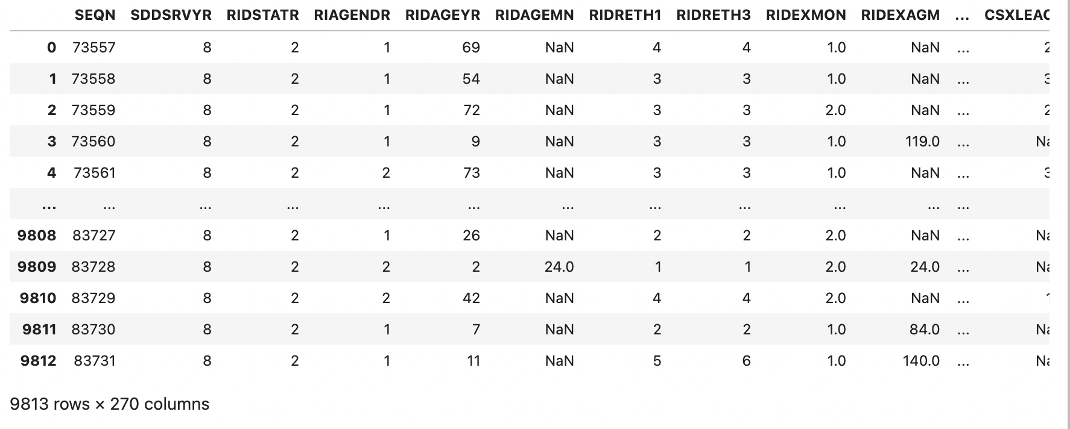
Data Table after Cleaning

Slide 11
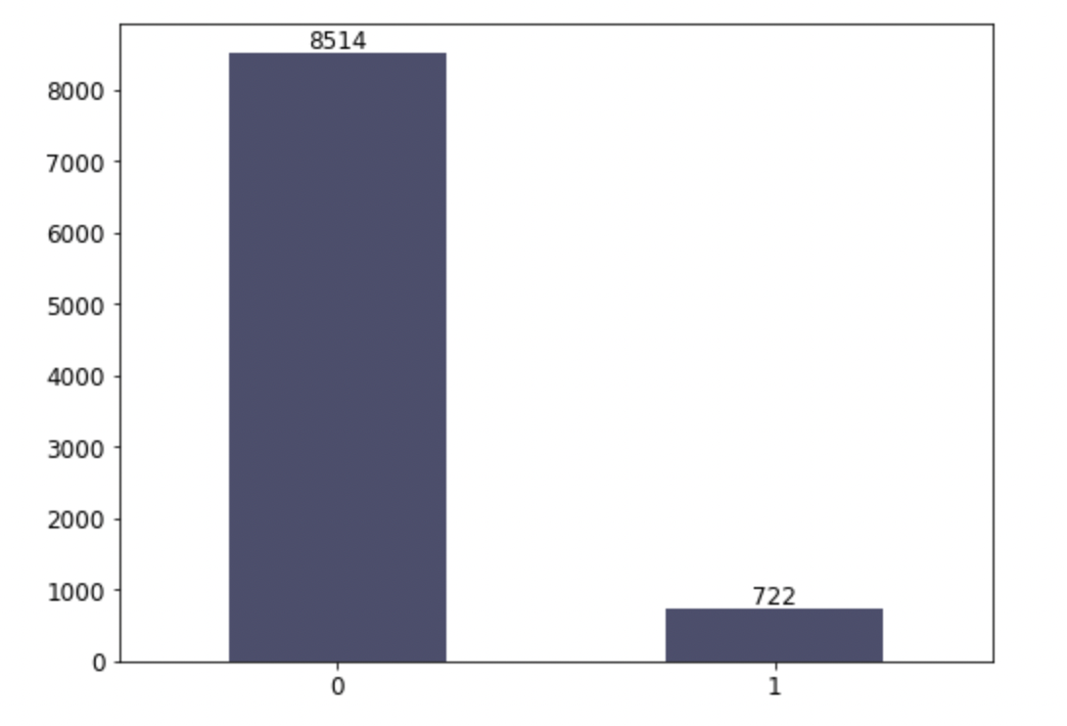
Response (DIQ010)
0: Doctor had never told a patient that he ever had diabetes.
1: Doctor had ever told a patient that he had diabetes.

Slide 12
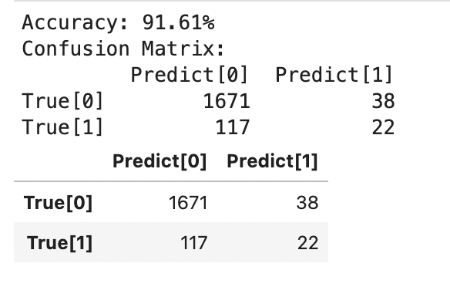
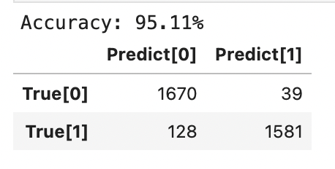
Feature Selection
XGBClassifier
Confusion Matrix
Oversampling with SMOTE( Synthetic Minority Oversampling Technique)
XGBoost
Notes:
parrellized

Slide 13
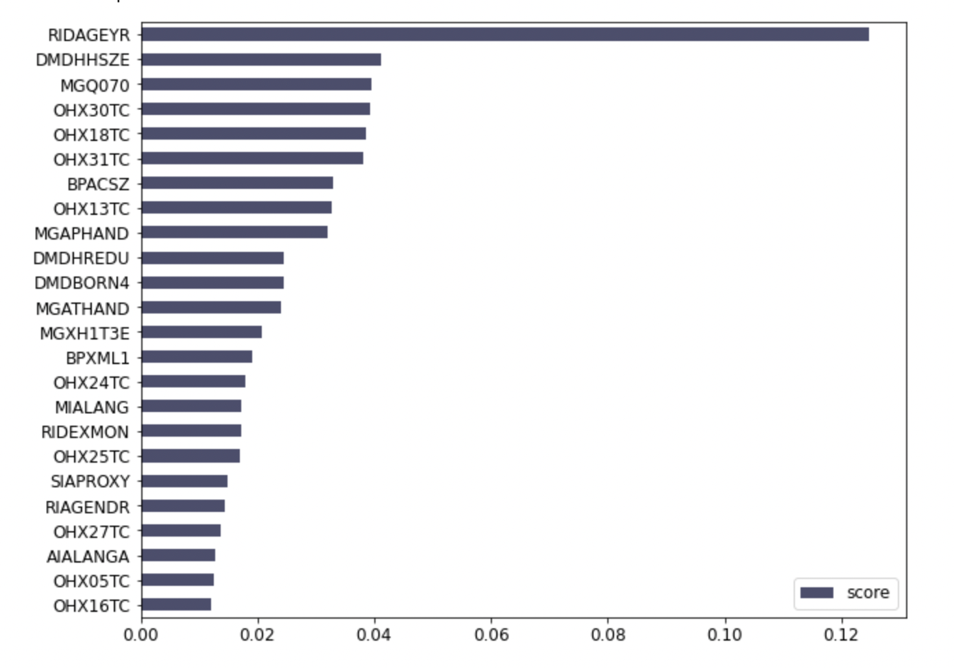
Feature Selection with XGBoost
RIDAGEYR: Age at screening
DMDHHSZE: # of adults 60 years or older in household
MGQ070: Recent pain/aching-right hand
OHX30TC: Tooth Count: Lower right 1st molar (1M)

Slide 14
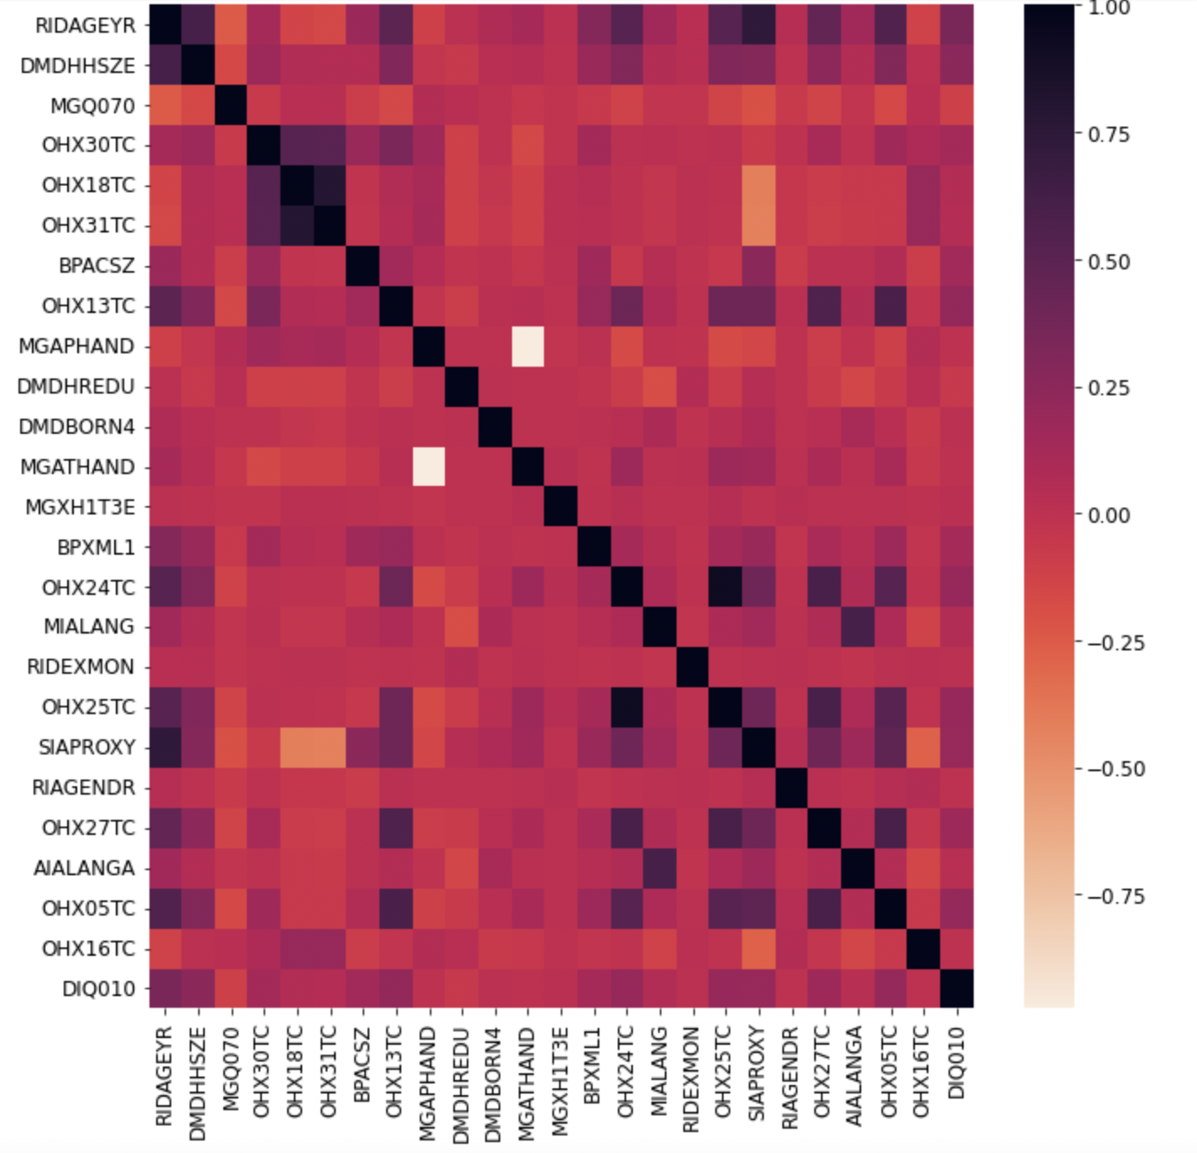
Exploratory Analysis:
Correlation Plot

Slide 15
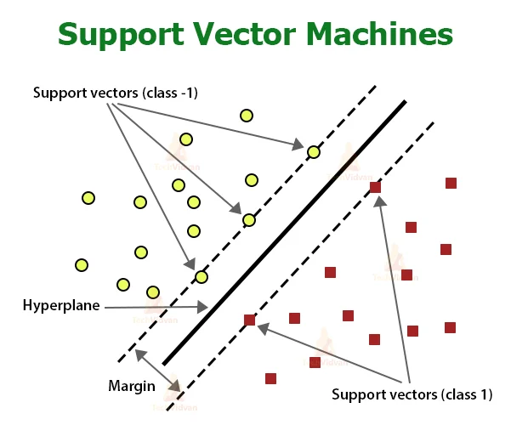

Model Selection
Logistic Regression (base): Used to estimate discrete values (Binary values like 0/1) based on a given set of the independent variables, fitting data to a logit function
SVM: find lines that split the data between the two differently classified groups of data . This will be the line such that the distances from the closest point in each of the two groups will be the farthest away.
Random Forest: Random Forest is a trademarked term for an ensemble of decision trees.
AdaBoostClassifier: AdaBoost is adaptive in the sense that subsequent weak learners are tweaked in favor of those instances misclassified by previous classifiers.
Gradient Boosting: Combine gradient descent and boosting together
XGBoost: Possesses both a linear model and the tree learning algorithm, making the algorithm almost 10 times faster than existing gradient booster techniques.

Slide 16
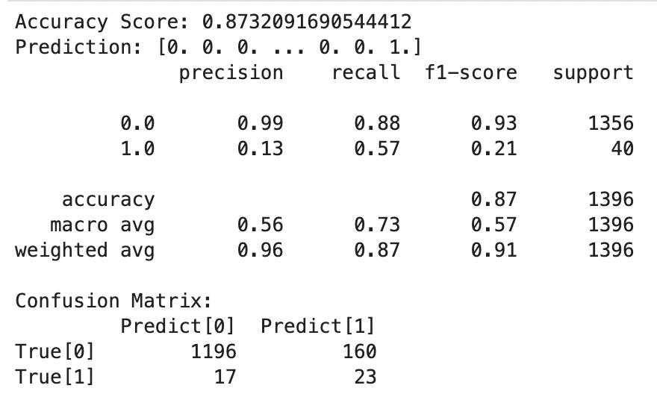
Model Selection (Random Forest)

Slide 17
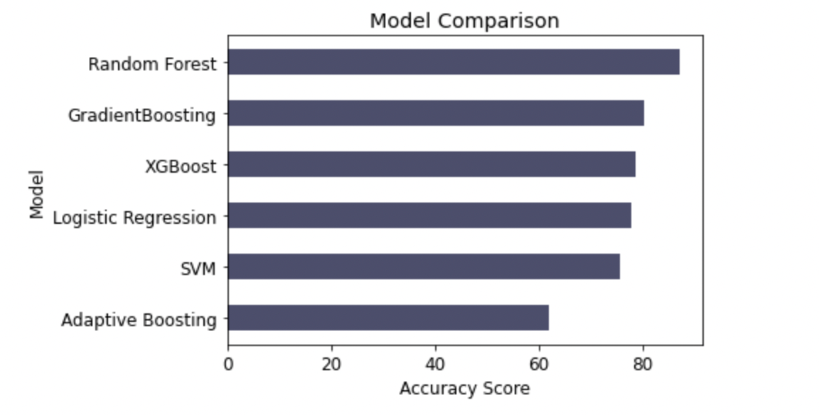
Model Comparison

Slide 18
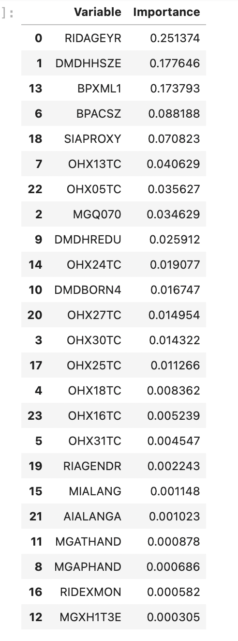
Importance Tree Random Forest
RIDAGEYR: Age at screening
DMDHHSZE: # of adults 60 years or older in household
BPXML1: MIL: maximum inflation levels (mm Hg)
BPACSZ: Cuff size (cm) (width X length)

Slide 19
Model Comparison
Model | Accuracy | Time
Logistic Regression | 78.01% | 0.87s
Random Forest | 87.32% | 0.21s
Gradient Boosting Decision Tree | 80.44% | 0.45s
SVM | 75.64% | 4.55s
Adaboost Classifier | 62.11% | 1.27s
XGBoost | 77.08% | 0.34s

Slide 20
Current Findings
Oversampling with SMOTE seems solve the imbalance of the response variable of the dataset
Random Forest seems to be the best one for diabetes prediction
Age, and number of adults 60 years or older in household, tend to be the commonly important features selected by XGBoost(XGBClassifier) and random forest prediction model

Slide 21
Diabetes Features and Models by Literature Review (Further Study)
Features
Gender
Length of time in US
family income/poverty guidelines
Glycohemoglobin (%)
Arm Circumference (cm)
Average Sagittal Abdominal Diameter (cm)
Combined grip strength (kg)
Breast-fed infant (either day)
k-nearest neighbors (KNN) & Multilayer perceptron (MLP)

Slide 22
Further Study
Applying an updated dataset recently
Performing statistical inference using our final model
Working more extensively on EDA
Model optimization/hyperparameter tuning
Ensemble
ROC/AUC comparison (receiver operating characteristic curve)
Adding more diseases (stroke, cardiovascular diseases, etc.), making comparisons

Slide 23
Credits
Myles, Anthony & Feudale, Robert & Liu, Yang & Woody, Nathaniel & Brown, Steven. (2004). An Introduction to Decision Tree Modeling. Journal of Chemometrics. 18(6). 275 - 285.
Biau, G., & Scornet, E. (2016). A random forest guided tour. Test, 25(2), 197-227.
Yao, Zizhen & Ruzzo, Walter. (2006). A Regression-based K nearest neighbor algorithm for gene function prediction from heterogeneous data. BMC bioinformatics, 7(1), 1–11.
Gardner, M., & Dorling, S. (1998). Artificial neural networks (the multilayer perceptron)—a review of applications in the atmospheric sciences. Atmospheric Environment, 32(14–15), 2627–2636.
Chen, T., & Guestrin, C. (2016). Xgboost: A scalable tree boosting system. In Proceedings of the 22nd acm sigkdd international conference on knowledge discovery and data mining. pp. 785-794.
Dagliati A, Marini S, Sacchi L, Cogni G, Teliti M, Tibollo V, De Cata P, Chiovato L, Bellazzi R. Machine Learning Methods to Predict Diabetes Complications. J Diabetes Sci Technol. 2018 Mar;12(2):295-302. doi: 10.1177/1932296817706375. Epub 2017 May 12. PMID: 28494618; PMCID: PMC5851210.
Palacios OM, Kramer M, Maki KC. Diet and prevention of type 2 diabetes mellitus: beyond weight loss and exercise. Expert Rev Endocrinol Metab. 2019 Jan;14(1):1-12. doi: 10.1080/17446651.2019.1554430. Epub 2018 Dec 6. PMID: 30521416.

Slide 24
Credits (cont’ d)
Cahn A, Shoshan A, Sagiv T, Yesharim R, Goshen R, Shalev V, Raz I. Prediction of progression from pre-diabetes to diabetes: Development and validation of a machine learning model. Diabetes Metab Res Rev. 2020 Feb;36(2):e3252. doi: 10.1002/dmrr.3252. Epub 2020 Jan 14. PMID: 31943669.
Slieker RC, van der Heijden AAWA, Siddiqui MK, Langendoen-Gort M, Nijpels G, Herings R, Feenstra TL, Moons KGM, Bell S, Elders PJ, 't Hart LM, Beulens JWJ. Performance of prediction models for nephropathy in people with type 2 diabetes: systematic review and external validation study. BMJ. 2021 Sep 28;374:n2134. doi: 10.1136/bmj.n2134. PMID: 34583929; PMCID: PMC8477272.
Deberneh HM, Kim I. Prediction of Type 2 Diabetes Based on Machine Learning Algorithm. Int J Environ Res Public Health. 2021 Mar 23;18(6):3317. doi: 10.3390/ijerph18063317. PMID: 33806973; PMCID: PMC8004981.
Katsimpris A, Brahim A, Rathmann W, Peters A, Strauch K, Flaquer A. Prediction of type 2 diabetes mellitus based on nutrition data. J Nutr Sci. 2021 Jun 21;10:e46. doi: 10.1017/jns.2021.36. PMID: 34221364; PMCID: PMC8223171.
Prabha A, Yadav J, Rani A, Singh V. Design of intelligent diabetes mellitus detection system using hybrid feature selection based XGBoost classifier. Comput Biol Med. 2021 Sep;136:104664. doi: 10.1016/j.compbiomed.2021.104664. Epub 2021 Jul 22. PMID: 34329866.
Han YM, Yang H, Huang QL, Sun ZJ, Li ML, Zhang JB, Deng KJ, Chen S, Lin H. Risk prediction of diabetes and pre-diabetes based on physical examination data. Math Biosci Eng. 2022 Feb 7;19(4):3597-3608. doi: 10.3934/mbe.2022166. PMID: 35341266.
Nayarisseri A, Khandelwal R, Tanwar P, Madhavi M, Sharma D, Thakur G, Speck-Planche A, Singh SK. Artificial Intelligence, Big Data and Machine Learning Approaches in Precision Medicine & Drug Discovery. Curr Drug Targets. 2021;22(6):631-655. doi: 10.2174/1389450122999210104205732. PMID: 33397265.

Slide 25
Q & A

